Slide 1

Unsupervised Learning Pt. 2
Supplementary Slides

Slide 2
Hierarchical Clustering

Slide 3
Hierarchical
Nested clusters
Idea of membership
Intuitive, explicative, and visualizable
Dendrograms
Use Cases: Genetics, evolutionary biology, user rec.

Slide 4
Motivation: Animal Dendrogram
Slug
Ugly
Slimy
Hairy
Bumpy
Tapeworm
. . .
Animal
Scary
Grizzly
Penguin
Land
Lemus
Cute
Water

Slide 5
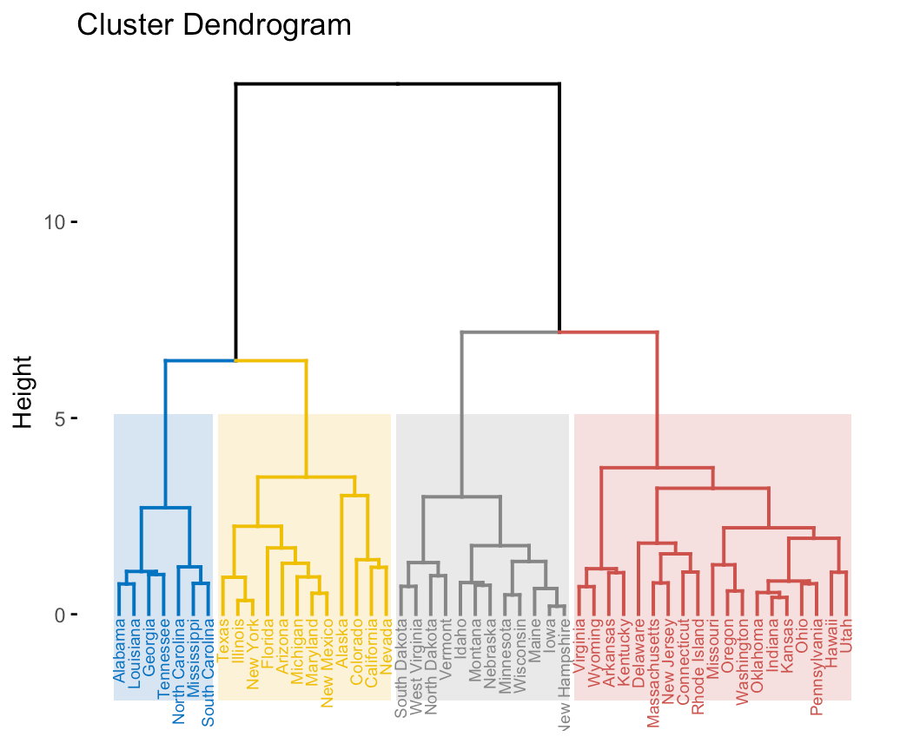
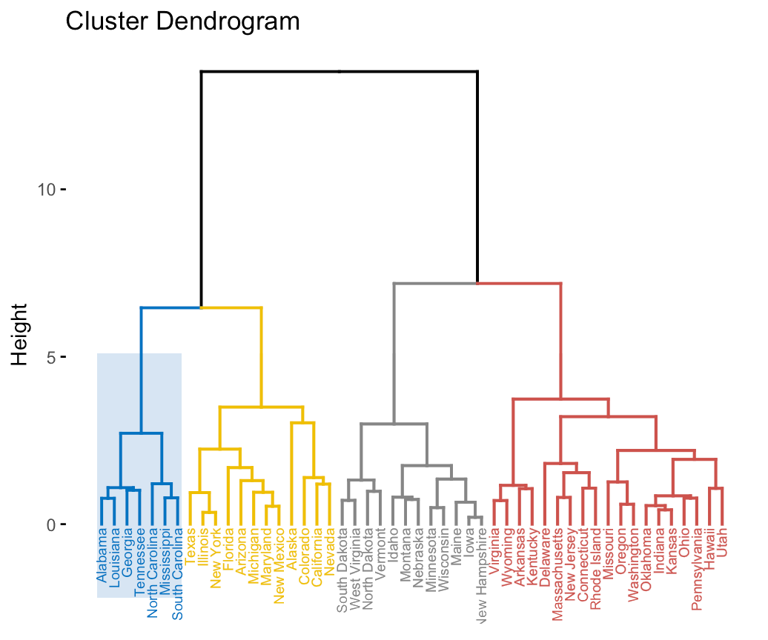
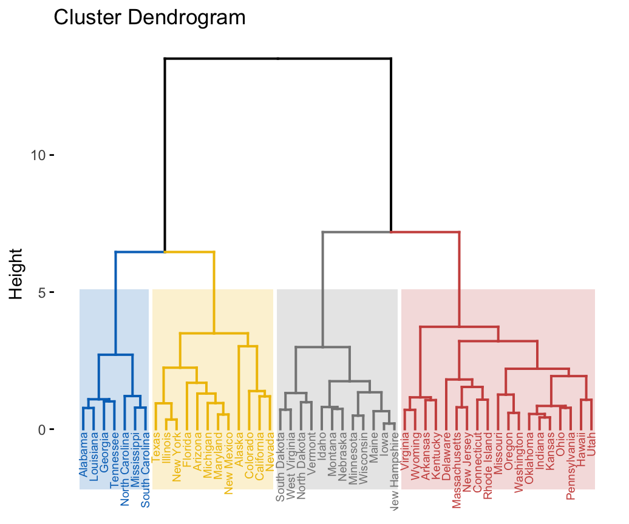
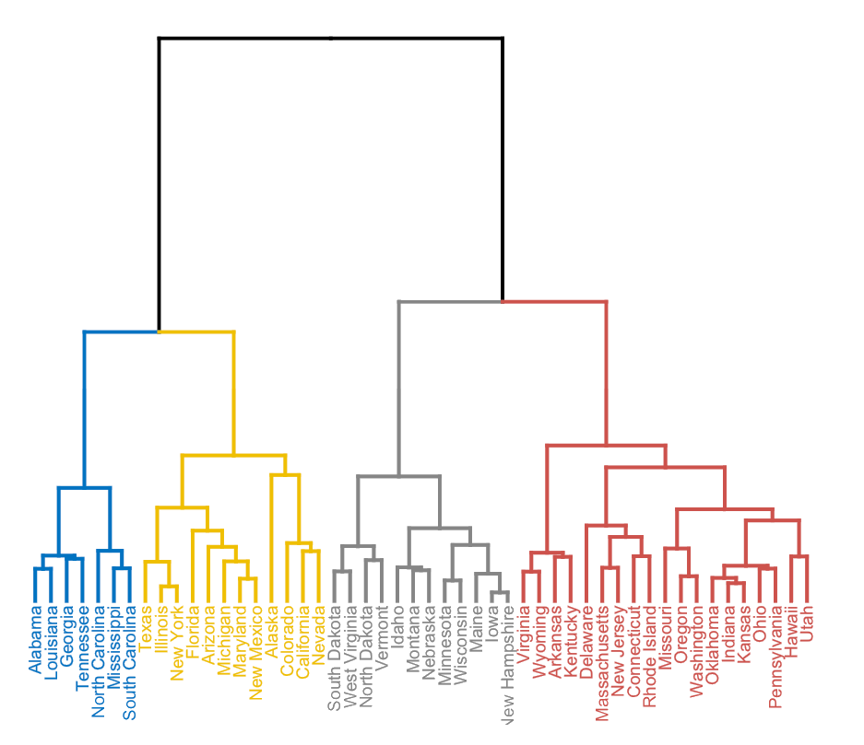
Dendrograms
Dendrogram
Indicates membership

Slide 6
Algorithm
1) Compute distances between all points/clusters
2) Place into proximity matrix
3) Find closest pair
4) Merge
5) Repeat 1-4 until only one
point/cluster exists

Slide 7
Algorithm
1) Compute distances between all points/clusters
2) Place into proximity matrix
3) Find closest pair
4) Merge
5) Repeat 1-4 until only one
point/cluster exists
A
A
A
A
A
A
A
A
A
A
A

Slide 8
Visualize: Proximity Matrix
 | A | B | CDG | E | FH | I
A | x | 134 | 12 | 85 | 74 | 32
B | 6.5 | x | 43 | 28 | 7.87 | 89
CDG | 123 | 89 | x | 2 | 32 | 73
E | 57 | 4 | 234 | x | 23 | 75
FH | 9 | 32 | 65 | 34 | x | 92
I | 46 | 221 | 523 | 82 | 6.43 | 81

Slide 9
Other Way to Visualize: “The Blob”

Slide 10
Challenges?
(complexity. speed. how to compute distances.)

Slide 11
Computing distances between clusters
Min
Max
Ward’s Method
...
Group Average
https://cs.wmich.edu/alfuqaha/summer14/cs6530/lectures/ClusteringAnalysis.pdf strencths and weaknesses
Notes:
https://towardsdatascience.com/understanding-the-concept-of-hierarchical-clustering-technique-c6e8243758ec

Slide 12
Computing distances between clusters
Min
Max
Ward’s Method
...
Group Average
Sim(C1,C2) =
Max Sim(Pi,Pj)
Sim(C1,C2) =
Min Sim(Pi,Pj)
Sim(C1,C2) =
∑ (dist(Pi, Pj))²/|C1|*|C2|
https://cs.wmich.edu/alfuqaha/summer14/cs6530/lectures/ClusteringAnalysis.pdf strencths and weaknesses
Notes:
https://towardsdatascience.com/understanding-the-concept-of-hierarchical-clustering-technique-c6e8243758ec

Slide 13
Hierarchical Pros and Cons
1) User understands the data
2) Reveals more info/hidden trends
3) Idea of “membership”
3) Don't need to specify # of clusters
4) Adjustable to improve accuracy
(ex distance measures)
5) Can handle non-spherical clusters
1) Complexity
On^2 space
On^3 time
2) Scalability
3) Handling noise
4) Settling on cluster distance computation
5) O(N^2logn) complexity

Slide 14
Density-Based Clustering

Slide 15
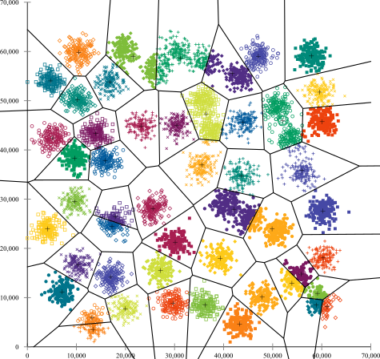
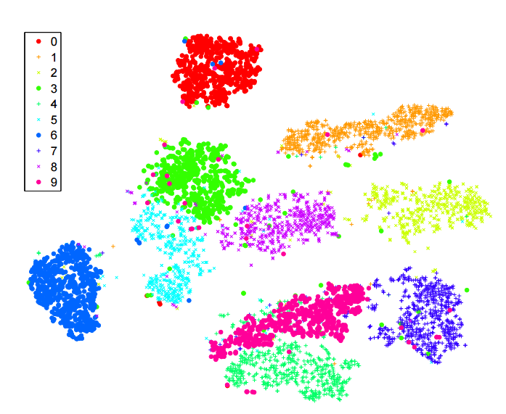
Motivation
Not all data is this “easy”
What is “simple” about this data?

Slide 16
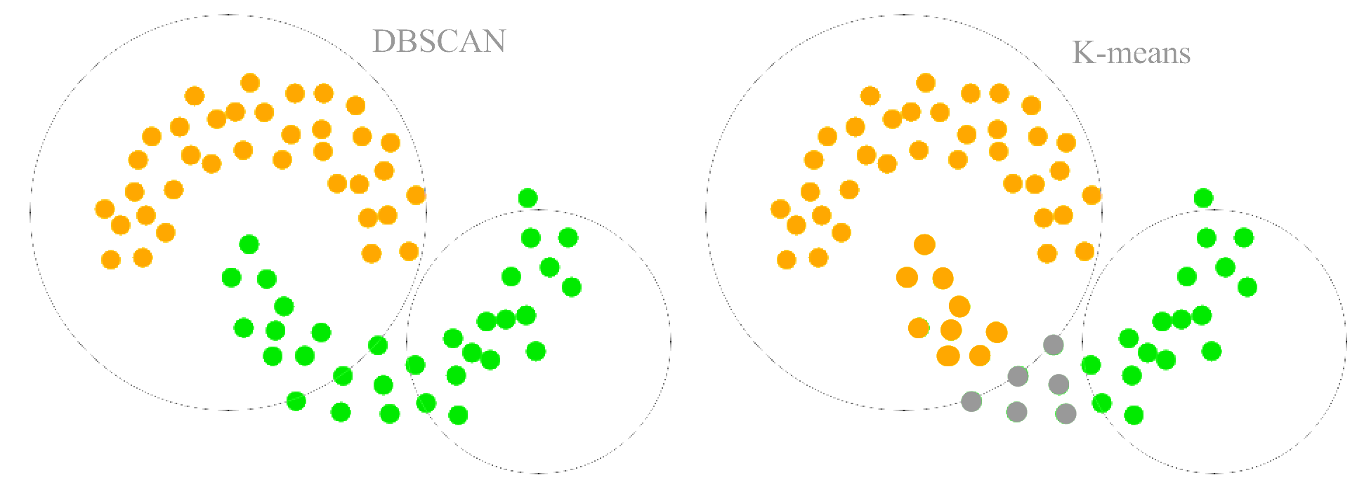
Handling Non-Elliptical Clusters

Slide 17
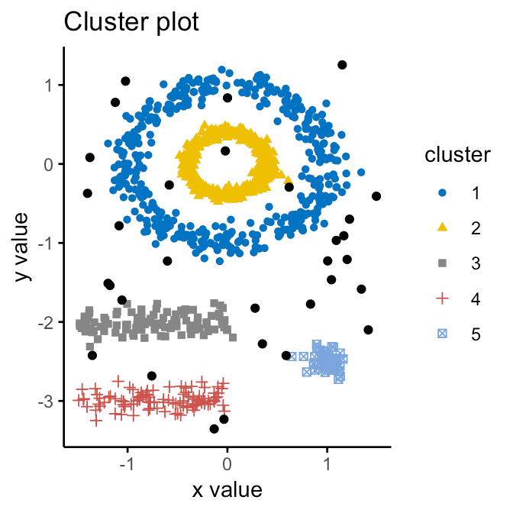
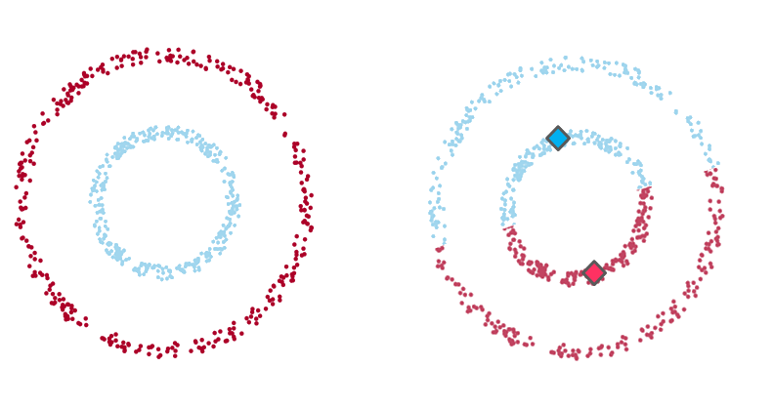
Non-Elliptical Continued

Slide 18
DBSCAN: Key Terms
Idea
Epsilon field
Like radius
Three types of points
Core
Border
Reachable
Noise/Outlier
E
Core
Notes:
https://towardsdatascience.com/understanding-the-concept-of-hierarchical-clustering-technique-c6e8243758ec

Slide 19
DBSCAN: Key Terms
Idea
Epsilon field
Like radius
Three types of points
Core
Border
Reachable
Noise/Outlier
Noise
Core
Notes:
https://towardsdatascience.com/understanding-the-concept-of-hierarchical-clustering-technique-c6e8243758ec

Slide 20
DBSCAN: Key Terms
Idea
Epsilon field
Like radius
Three types of points
Core
Border
Reachable
Noise
Noise
Core
Border
Notes:
https://towardsdatascience.com/understanding-the-concept-of-hierarchical-clustering-technique-c6e8243758ec

Slide 21
DBSCAN Algorithm
Given e and min_num
Classify points
Core point if:
min_num points are within e
Border if:
if within epsilon of a core point
Outlier if:
Not reachable by core
2) Group Core Points into one cluster
Notes:
https://www.coursera.org/lecture/machine-learning-with-python/dbscan-B8ctK

Slide 22
DBSCAN Algorithm
Given e and min_num
Classify points
Core point if:
min_num points are within e
Border if:
if within epsilon of a core point
Outlier if:
Not reachable by core
2) Group Core Points into one cluster
Notes:
https://www.coursera.org/lecture/machine-learning-with-python/dbscan-B8ctK

Slide 23
DBSCAN Algorithm
Given e and min_num
Classify points
Core point if:
min_num points are within e
Border if:
if within epsilon of a core point
Outlier if:
Not reachable by core
2) Group Core Points into one cluster
Notes:
https://www.coursera.org/lecture/machine-learning-with-python/dbscan-B8ctK

Slide 24
DBSCAN Algorithm
Given e and min_num
Classify points
Core point if:
min_num points are within e
Border if:
if within epsilon of a core point
Outlier if:
Not reachable by core
2) Group Core Points into one cluster
Notes:
https://www.coursera.org/lecture/machine-learning-with-python/dbscan-B8ctK

Slide 25
DBSCAN Algorithm
Given e and min_num
Classify points
Core point if:
min_num points are within e
Border if:
if within epsilon of a core point
Outlier if:
Not reachable by core
2) Group Core Points into one cluster
Notes:
https://www.coursera.org/lecture/machine-learning-with-python/dbscan-B8ctK

Slide 26
DBSCAN Algorithm
Given e and min_num
Classify points
Core point if:
min_num points are within e
Border if:
if within epsilon of a core point
Outlier if:
Not reachable by core
2) Group Core Points into one cluster
Notes:
https://www.coursera.org/lecture/machine-learning-with-python/dbscan-B8ctK

Slide 27
DBSCAN Algorithm
Given e and min_num
Classify points
Core point if:
min_num points are within e
Border if:
if within epsilon of a core point
Outlier if:
Not reachable by core
2) Group Core Points into one cluster
Notes:
https://www.coursera.org/lecture/machine-learning-with-python/dbscan-B8ctK

Slide 28
DBSCAN Pros and Cons
1) Arbitrarily-shaped clusters
2) Non-linearly separable clusters
2) Don't need to specify cluster count
3) Robust to noise
1) Considers low density as outliers
2) Scalability
Harms Euclidean distance measures
3) Assumes constant density

